Slide 1
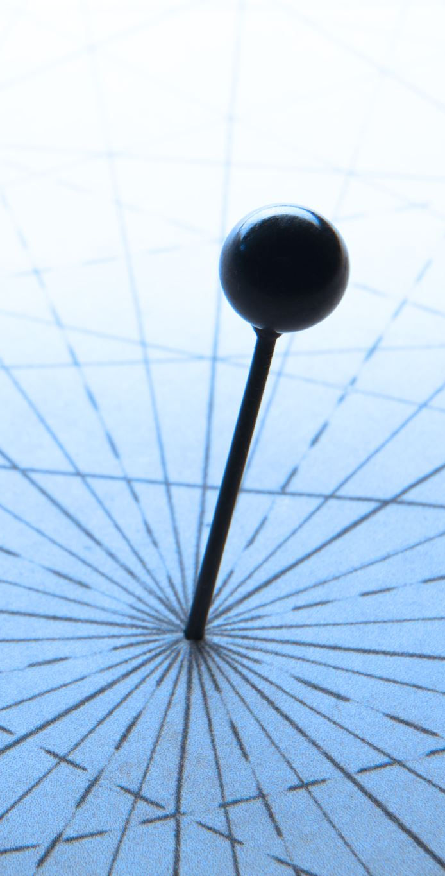
Coordinate System
Hung-yi Lee

Slide 2
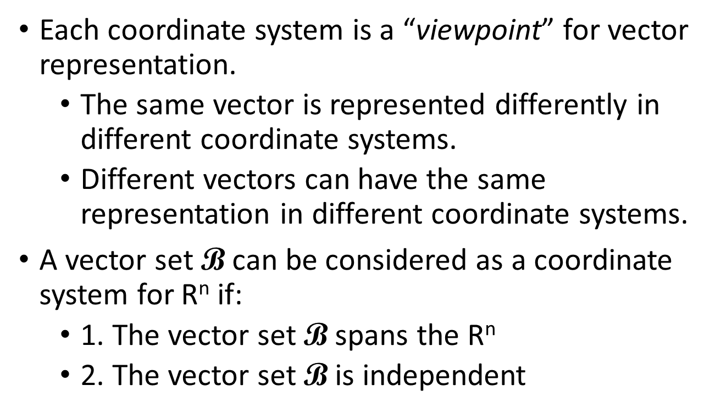

Coordinate System
Each coordinate system is a “viewpoint” for vector representation.
The same vector is represented differently in different coordinate systems.
Different vectors can have the same representation in different coordinate systems.
A vector set $\text{B}$ can be considered as a coordinate system for R^{n} if:
1. The vector set $\text{B}$ spans the R^{n}
2. The vector set $\text{B}$ is independent
$\text{B}$ is a basis of R^{n}
Notes:
ㄑ一ㄡ
ㄆㄧㄢˋ ㄐㄩ
除 換
神話傳說中的野獸。形似猿猴。《莊子．齊物論》：「猨，猵狙以為雌。」

Slide 3
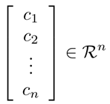
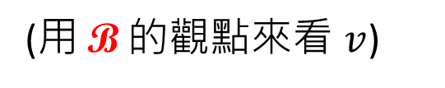



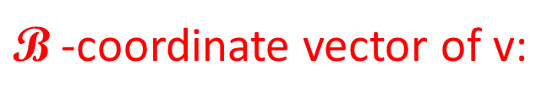
Coordinate System
Let vector set $\text{B}\text{=}\left\{u_{1},u_{2},⋯,u_{n}\right\}$ be a basis for a subspace R^{n}
For any v in R^{n}, there are unique scalars $c_{1},c_{2},⋯,c_{n}$ such that $v=c_{1}u_{1}+c_{2}u_{2}+⋯+c_{n}u_{n}$
$\text{B}$ is a coordinate system
$\text{B}$-coordinate vector of v:
$${\left[v\right]}_{\text{B}}=$$
(用 $\text{B}$ 的觀點來看 $v$)
Notes:
$$\text{(}\text{某種觀點}\text{)}$$
根據某種觀點所看到的結果

Slide 4
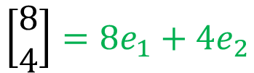










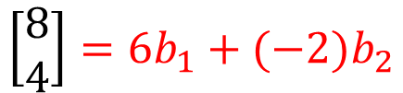


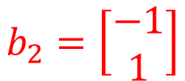


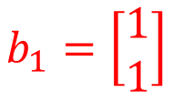
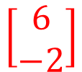
New Coordinate System
$$\text{B}$$
$$\text{E}$$
$$b_{1}=\left[\begin{aligned}1 \\ 1\end{aligned}\right]$$
$$b_{2}=\left[\begin{aligned}−1 \\ 1\end{aligned}\right]$$
{e₁, e₂} is a coordinate system
$${6b}_{1}$$
$$\left[\begin{aligned}8 \\ 4\end{aligned}\right]$$
$$\left[\begin{aligned}8 \\ 4\end{aligned}\right]$$
$${\left[v\right]}_{\text{E} }=$$
$${\left[v\right]}_{\text{B}}=$$
$${4e}_{2}$$
$$\left[\begin{aligned}6 \\ −2\end{aligned}\right]$$
$$b_{1}$$
$$e_{2}$$
$$b_{2}$$
$$e_{1}$$
$${8e}_{1}$$
$${−2b}_{2}$$
$$\left[\begin{aligned}8 \\ 4\end{aligned}\right]=8e_{1}+4e_{2}$$
$$\left[\begin{aligned}8 \\ 4\end{aligned}\right]=6b_{1}+(−2)b_{2}$$

Slide 5
民濕寢則腰疾偏死，鰌然乎哉？木處則惴慄恂懼，猨猴然乎哉？三者孰知正處？民食芻豢，麋鹿食薦，蝍蛆甘帶，鴟鴉嗜鼠，四者孰知正味？猨猵狙以為雌，麋與鹿交，鰌與魚游。毛嬙、西施，人之所美也；魚見之深入，鳥見之高飛，麋鹿見之決驟，四者孰知天下之正色哉？《莊子‧齊物論》

Slide 6



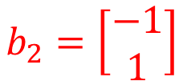
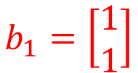

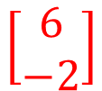

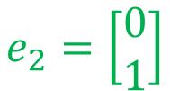



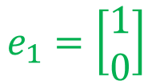
Vector
$$\left[\begin{aligned}8 \\ 4\end{aligned}\right]$$
$$\left[\begin{aligned}6 \\ −2\end{aligned}\right]$$
drink
home
$$e_{2}$$
$$b_{1}$$
$$b_{2}$$
$$e_{1}$$
$$e_{1}=\left[\begin{aligned}1 \\ 0\end{aligned}\right]$$
$$e_{2}=\left[\begin{aligned}0 \\ 1\end{aligned}\right]$$
$$b_{1}=\left[\begin{aligned}1 \\ 1\end{aligned}\right]$$
$$b_{2}=\left[\begin{aligned}−1 \\ 1\end{aligned}\right]$$

Slide 7
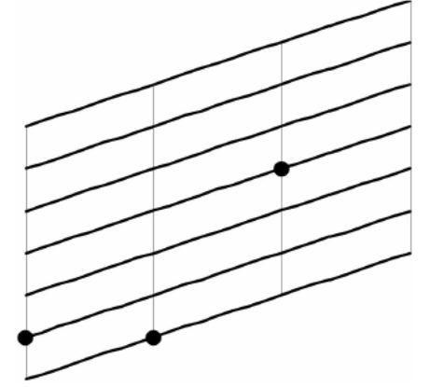
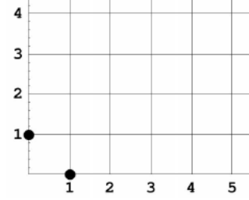
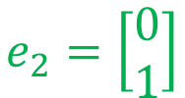

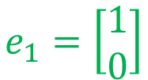

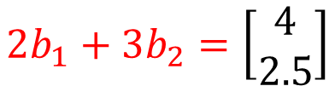
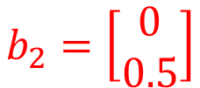

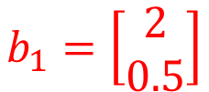




Vector
$$e_{1}=\left[\begin{aligned}1 \\ 0\end{aligned}\right]$$
$$e_{2}=\left[\begin{aligned}0 \\ 1\end{aligned}\right]$$
$$b_{1}=\left[\begin{aligned}2 \\ 0.5\end{aligned}\right]$$
$$b_{2}=\left[\begin{aligned}0 \\ 0.5\end{aligned}\right]$$
$$\left[\begin{aligned}2 \\ 3\end{aligned}\right]$$
$$\left[\begin{aligned}2 \\ 3\end{aligned}\right]$$
$\left[\begin{aligned}4 \\ 2.5\end{aligned}\right]$ for left
$$e_{2}$$
$$b_{2}$$
$$b_{1}$$
$$e_{1}$$
$$2b_{1}+3b_{2}=\left[\begin{aligned}4 \\ 2.5\end{aligned}\right]$$

Slide 8
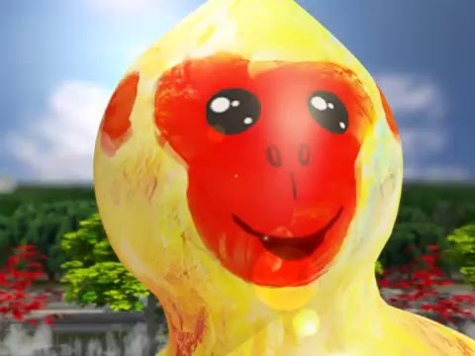
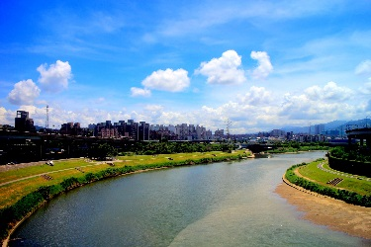
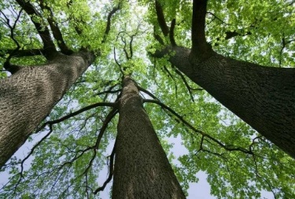
Vector
$$e_{1}=\left[\begin{aligned}1 \\ 0\end{aligned}\right]$$
$$e_{2}=\left[\begin{aligned}0 \\ 1\end{aligned}\right]$$
$$b_{1}=\left[\begin{aligned}2 \\ 0.5\end{aligned}\right]$$
$$b_{2}=\left[\begin{aligned}0 \\ 0.5\end{aligned}\right]$$
$$\left[\begin{aligned}2 \\ 3\end{aligned}\right]$$
home
$$\left[\begin{aligned}2 \\ 3\end{aligned}\right]$$
home
$\left[\begin{aligned}4 \\ 2.5\end{aligned}\right]$ for left
$$e_{2}$$
$$b_{2}$$
$$b_{1}$$
$$e_{1}$$
$$2b_{1}+3b_{2}=\left[\begin{aligned}4 \\ 2.5\end{aligned}\right]$$

Slide 9



New Coordinate System
$$\text{B}$$
$$\text{E}$$
$$b_{1}=\left[\begin{aligned}1 \\ 1\end{aligned}\right]$$
$$b_{2}=\left[\begin{aligned}−1 \\ 1\end{aligned}\right]$$
{e₁, e₂} is a coordinate system
$${6b}_{1}$$
$$\left[\begin{aligned}8 \\ 4\end{aligned}\right]$$
$${\left[v\right]}_{\text{B}}=$$
$${\left[v\right]}_{\text{E} }=$$
$${4e}_{2}$$
$$\left[\begin{aligned}6 \\ −2\end{aligned}\right]$$
$$b_{1}$$
$$e_{2}$$
$$b_{2}$$
$$e_{1}$$
$${8e}_{1}$$
$${−2b}_{2}$$
$$\left[\begin{aligned}8 \\ 4\end{aligned}\right]=8e_{1}+4e_{2}$$
$$\left[\begin{aligned}8 \\ 4\end{aligned}\right]=6b_{1}+(−2)b_{2}$$
$$\text{E}\text{=}\left\{e_{1},e_{2},⋯,e_{n}\right\}$$
(standard vectors)
$v={\left[v\right]}_{\text{E}}$
$\text{E}$ is Cartesian coordinate system
(直角坐標系)

Slide 10

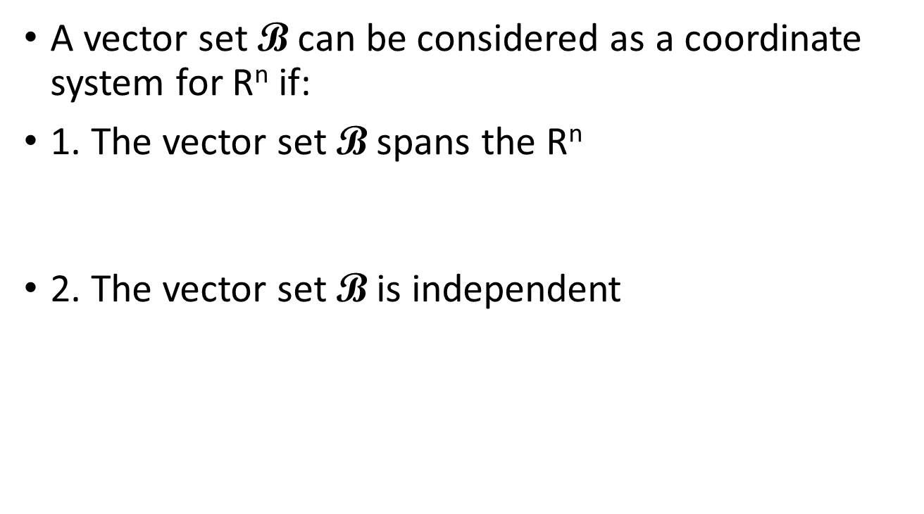
Coordinate System
A vector set $\text{B}$ can be considered as a coordinate system for R^{n} if:
1. The vector set $\text{B}$ spans the R^{n}
2. The vector set $\text{B}$ is independent
Every vector should have representation
Unique representation
$\text{B}$ is a basis of R^{n}

Slide 11

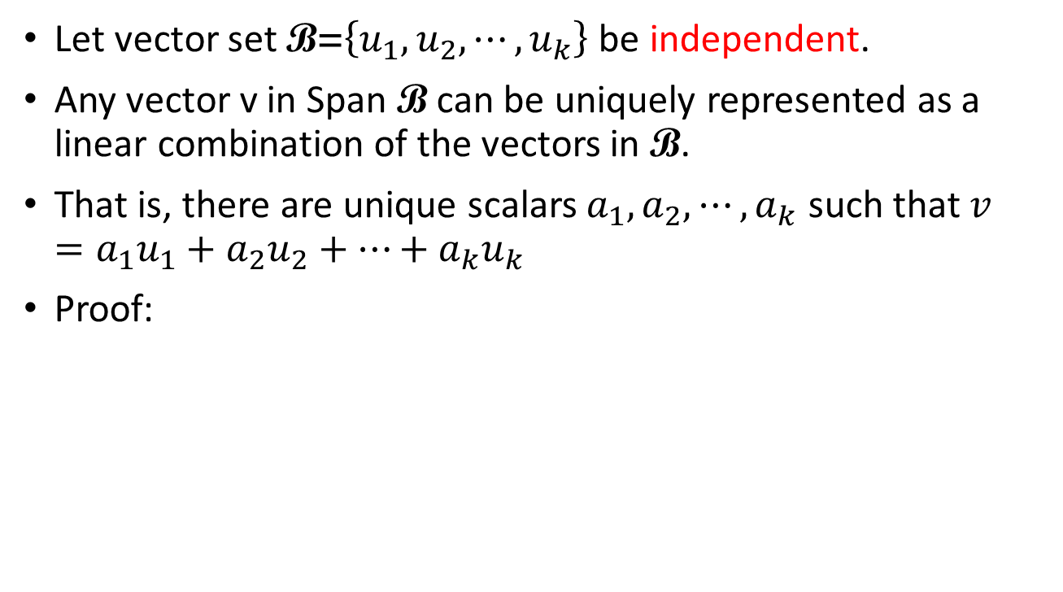

Why Basis?
Let vector set $\text{B}\text{=}\left\{u_{1},u_{2},⋯,u_{k}\right\}$ be independent.
Any vector v in Span $\text{B}$ can be uniquely represented as a linear combination of the vectors in $\text{B}$.
That is, there are unique scalars $a_{1},a_{2},⋯,a_{k}$ such that $v=a_{1}u_{1}+a_{2}u_{2}+⋯+a_{k}u_{k}$
Proof:
Unique?
$$v=a_{1}u_{1}+a_{2}u_{2}+⋯+a_{k}u_{k}$$
$$v=b_{1}u_{1}+b_{2}u_{2}+⋯+b_{k}u_{k}$$
$$\left({a_{1}−b}_{1}\right)u_{1}+\left({a_{2}−b}_{2}\right)u_{2}+⋯+\left({a_{k}−b}_{k}\right)u_{k}=0$$
B is independent
a₁ − b₁ = a₂ − b₂ = ☹ = a_{k} − b_{k} = 0

